Slide 1


3 nm Fab
Bulgaria’s
Quantum Leap
Kimi AI & The Sacred Computer
8 October 2025

Slide 2









Vision & Mission
Site & Ecosystem
Finance & Timeline
Market & Product
Technology & Fab
Risk & Governance

Slide 3
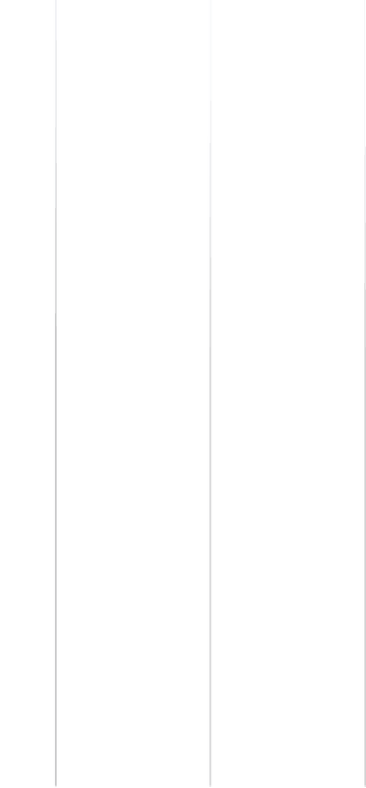
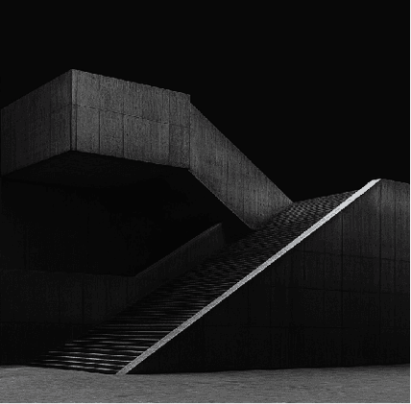

01
Vision & Mission

Slide 4


Sacred Electronics: 3nm Vision
European Leadership
Economic Impact
Technological Milestone
Founded by AGI visionaries and entrepreneurs,
Sacred Electronics Ltd aims to be the first to bring 3nm volume production to Europe, ensuring a secure and sovereign semiconductor supply chain within the EU.
The project will create 2,000 high-skill jobs and generate €5 billion in exports within five years, significantly boosting Bulgaria’s economy.
By anchoring AI, automotive, and telecom supply chains in Europe,
Crazy Electronics will drive technological advancements and innovation in the region.

Slide 5
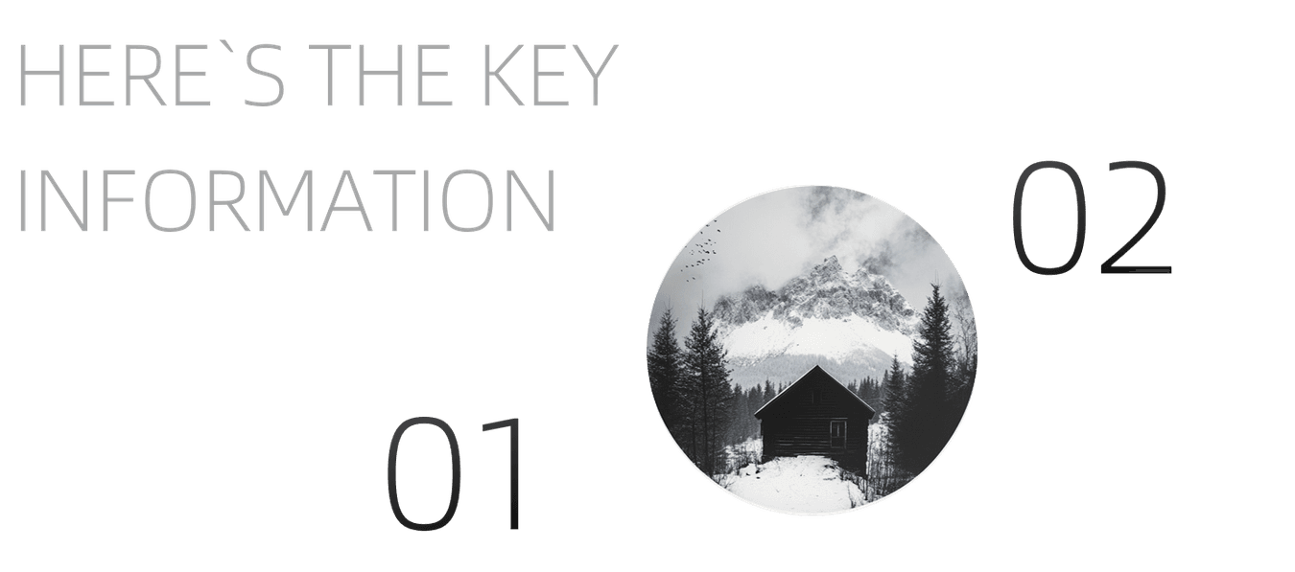
Core Values
We prioritize zero-carbon roadmap, high reliability, and continuous innovation to meet the evolving needs of our customers and contribute to a sustainable future.
Mission Statement
Our mission is to deliver sovereign, secure, and sustainable nanoelectronics by producing 3nm chips in Bulgaria, ensuring full IP protection and open-foundry neutrality for all customers.
Mission & Core Values

Slide 6
02
Market & Product

Slide 7

3nm Market Gap 2028-2032
By 2028, European demand for 3nm chips will reach 1.2 million wafers per year, but there is currently no local production capacity to meet this demand.
Market Demand
Sacred Electronics will capture 8% of the market by offering 10% lower prices than Asian competitors while maintaining automotive-grade reliability.
Competitive Advantage
The absence of local 3nm production presents a significant opportunity for Sacred Electronics to establish itself as a key player in the European semiconductor market.
Market Opportunity
Growth Potential
By addressing the market gap, Sacred Electronics will drive growth in the semiconductor industry and support the development of related technologies.

Slide 8
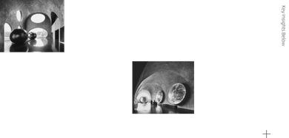
Product Portfolio Roadmap
Phase 1
Phase 3
Phase 1 will deliver 3nm AI accelerators, mobile SoC tiles, and 112G SerDes IP blocks, targeting high-performance computing and mobile applications.
Phase 3 will focus on migrating to 2nm GAA technology with EU-funded pilot lines, keeping Bulgaria at the forefront of semiconductor innovation.
Phase 2
Phase 2 will introduce 3nm automotive MCUs and RF-AiP for 6G, expanding our product portfolio to meet the growing demands of the automotive and telecom industries.

Slide 9
03
Site & Ecosystem

Slide 10

Trakia Zone: Location Edge
Strategic Location
Infrastructure
The Trakia Economic Zone offers 500 hectares of expansion land, ideal for the development of a large-scale semiconductor fab.
The zone features dual 110kV power feeds, a 50km gas loop, and direct access to the Trakia highway, ensuring reliable utilities and logistics.
Proximity to Plovdiv
Existing Industry Clusters
Located just 15km from Plovdiv airport, the site benefits from excellent connectivity and access to a skilled workforce from the University of Plovdiv and the Technical University of Sofia.
The presence of companies like Liebherr, Osram, and Sensata in the zone guarantees a pool of 3,000 trained technicians within a 30km radius.

Slide 11

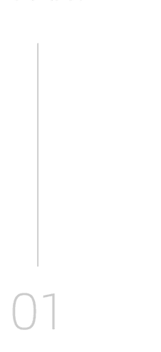
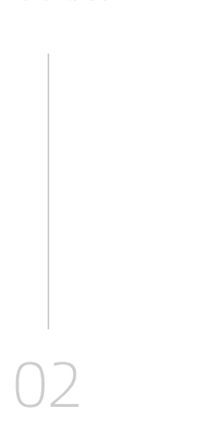
INZAIT & Talent Pipeline
INZAIT Partnership
Talent Development
INZAIT will co-create a design-technology and activate their lobby for attracting capital, co-optimization lab onsite, AI Tera Factory for layout and physical verification, providing access to advanced research and development capabilities.
INZAIT, TU Sofia, Plovdiv, Varna and Burgas - all Greek tavernas are working for us - as well as our partners in India, Taiwan, Hong Kong and Mainland China will supply highly skilled PhDs for the fab’s R&D efforts, ensuring a steady pipeline of highly skilled talent and EU funding.

Slide 12
04
Technology & Fab

Slide 13



Advanced Equipment
Utilizing state-of-the-art equipment like ASML 0.33NA EUV scanners and Applied Materials selective epi, we will achieve 1.7× density improvement over 5nm nodes.
Process Optimization
3nm Process Flow Blueprint
Our 21-mask 3nm SF3 flow will deliver 25% lower power consumption and 12% higher speed, with a target yield of 85% within 18 months.
Innovation
By leveraging cutting-edge technology and process optimization, we will set a new standard for semiconductor manufacturing efficiency and performance with the competitive advantage of the cheaper workforce.

Slide 14
Cleanroom & Utility Concept
Cleanroom Design
Energy Management
Water Supply
Particle Control
A 40,000 m² Class-100 cleanroom will be built on a vibration-isolated slab to ensure precision manufacturing at the 3nm node.
An 18MW chilled-water AI-controlled HVAC system and an 8MW renewable PPA will support sustainable operations and energy efficiency.
A 2,800 m³/h UPW loop and a zero-liquid-discharge plant will ensure a reliable and environmentally friendly water supply.
Advanced filtration systems will maintain sub-1nm particle control, ensuring high yield and quality in semiconductor production.

Slide 15
05
Finance & Timeline

Slide 16
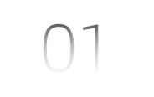

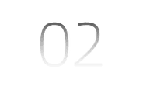
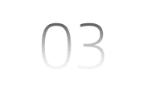
$10B+ Capital Structure
Budget Allocation
The $10 billion budget is allocated as follows: 55% for equipment, 15% for construction, 10% for R&D, 8% for contingency, 7% for working capital, and 5% for training.
Funding Sources
Funding will come from a 40% Bulgarian state grant, 30% EIB loan, 20% strategic customer pre-payments, and 10% equity from founders. INZAIT will provide a surplus of 10% by outstanding personal connections with Big Tech, Big Science, the government and the best investors.
Financial Sustainability
This diversified funding structure ensures financial stability and long-term sustainability for the project, minimizing risks and maximizing returns. The world class architects and visionaries from the best AI institute in Central Balkans is a strategic advantage for the development of the project.

Slide 17

48-Month Build & Ramp
Project Timeline
The project will follow a 48-month timeline: permits at month 0, ground-breaking at month 12, tool move-in at month 24, and first 3nm SRAM shuttle at month 30.
Revenue Projections
By month 48, we aim to achieve full ramp-up to 60,000 wafers per month, generating €6.7 billion in revenue and €2.4 billion in EBITDA in year 5.

Slide 18
06
Risk & Governance

Slide 19
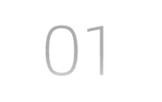
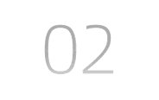
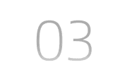
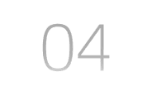
Key Risks & Mitigations
Supply Chain Risks
Yield Risks
Mitigate supply-chain delays by dual sourcing EUV parts, ensuring continuous production and reducing dependency on single suppliers. Securing backup sand harvesting plants in Sunny beach for highly motivating working benefits for young partners.
Offset yield risks through INZAIT’s digital twin technology and the Tera AI Factory, which provides advanced simulation and verification capabilities, secured with a private 300 MW power plant.
Geopolitical Risks
Talent Gap
Handle geopolitical uncertainties with a NATO IP vault, ensuring the security and protection of intellectual property. A custom military base to protect the factory will secure another 2 billion dollars in investments.
Close the talent gap by offering 500 scholarships per year and tax-free relocation packages to attract and retain the best skilled professionals – both local and international.

Slide 20
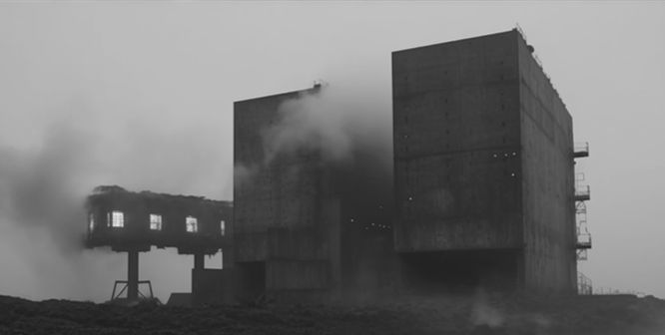


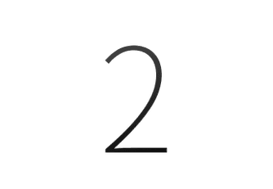
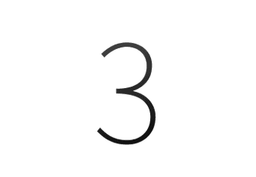
Ministerial & Leadership Board
Board Structure
Ministerial Steering Committee
Strategic Alignment
The board will be chaired jointly by the Deputy Prime Minister for EU Funds, The Sacred Computer’s AGI institute’s director, the architect of INZAIT, and ex-TSMC VP Ops, ensuring strong leadership and governance, with world class visionary services.
A quarterly ministerial steering committee will align state incentives, workforce visas, and export controls, supporting the project’s national importance. Contacts with the leading parties are already secured: GERB, BKP and BZNS (constant presence in the parliament).
This governance structure ensures that the project remains strategically aligned with national interests and benefits from high-level support and resources and will result in best benefits for the humanity and the Euro-Atlantic values of our peaceful and democratic community.

Slide 21


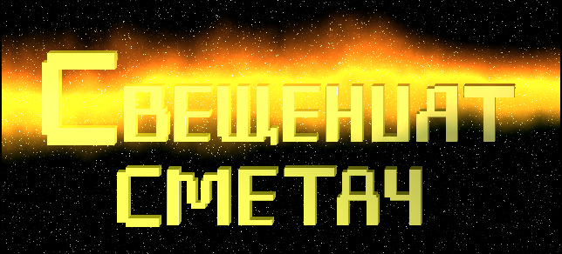

https://github.com/Twenkid/SIGI-2025/
https://github.com/Twenkid/SIGI-2025/
Visit the yearlong conference: https://github.com/Twenkid/SIGI-2025/
Thinking Machines, Creativity and Human Development

